Slide 1
Basic analysis

Slide 2
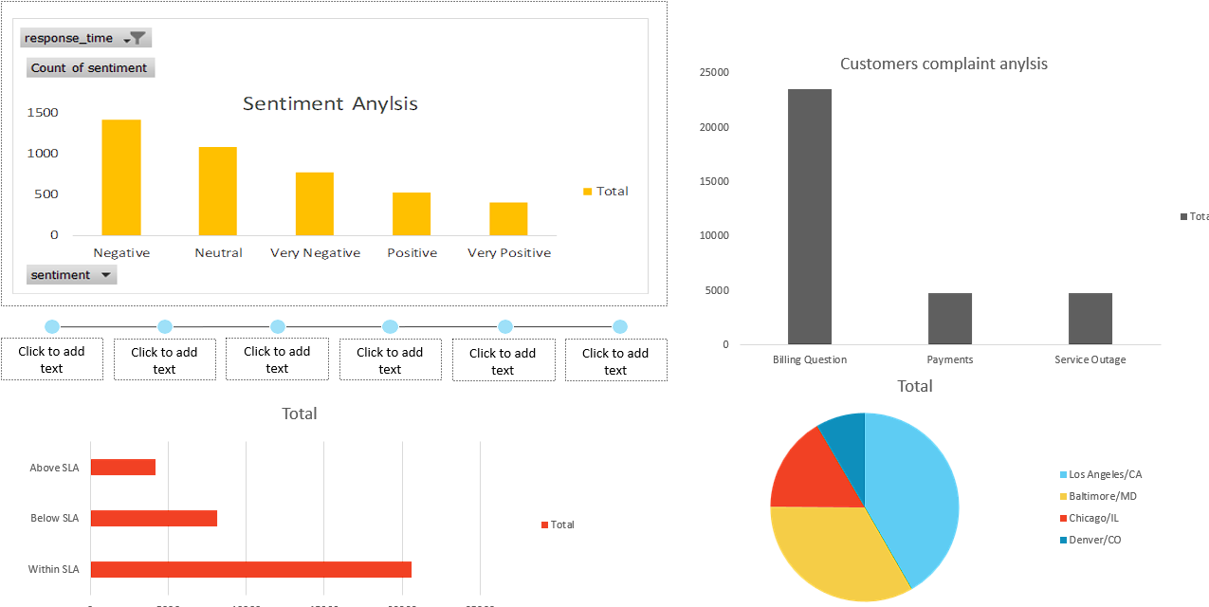
Instructions
Findings Basic Analysis
Analysis of customer feedback indicates a prevalent trend of negative sentiments towards call centers, with a notable abundance of neutral responses and a comparatively lower occurrence of positive and very positive feedback. This underscores the imperative for call centers to proactively enhance their service quality.
A comprehensive examination of customer inquiries reveals that billing-related questions are the most frequently raised concerns, closely followed by payment-related queries and service outages. It is paramount for call centers to meticulously elucidate all facets of product billing to minimize the frequency of billing-related inquiries, given the substantial disparity between these queries and other grievances.
Performance metrics indicate that the majority of tasks are accomplished within the Service Level Agreement (SLA), followed by those falling below SLA and, to a lesser extent, above SLA. While this is commendable, concerted efforts should be directed towards mitigating the number of SLA breaches, as persistent instances can potentially lead to critical issues, necessitating a proactive approach to curtail such occurrences.
Geographically, the distribution of call centers reveals a concentration in the Within LA region, followed by Baltimore, Chicago, and Denver. It is advisable for companies to strategically expand their call center presence in their respective regions to optimize service levels and cater to regional nuances, thereby contributing to a more effective and localized customer support experience.

Slide 3
Call Duration analysis

Slide 4
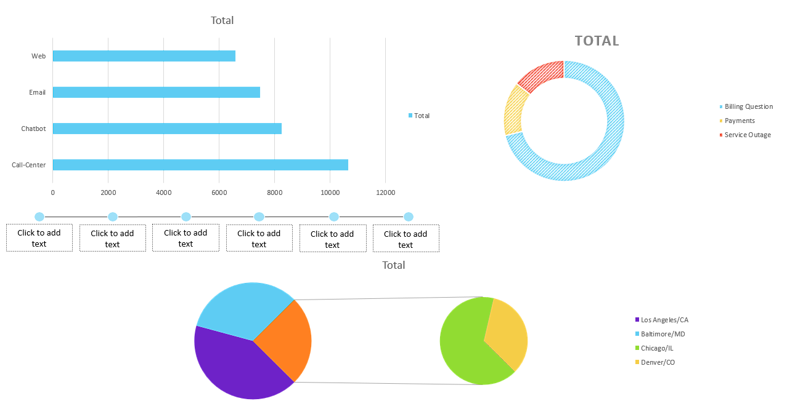
Instructions
Call duration analysis findings
The predominant channel for customer engagement is through call centers, with the highest duration of interaction, followed by interactions with chatbots, emails, and web interactions. Notably, the most extensive duration is associated with calls, underscoring the significance of telephonic communication in customer interactions.
A detailed examination of the nature of inquiries reveals that the highest amount of time is dedicated to addressing billing questions, followed by payment-related issues and service outages. It is imperative for companies to allocate adequate resources to address these prevalent concerns, while also ensuring sufficient attention is given to other queries to maintain the overall operational efficiency of the organization.
In terms of geographical distribution, the highest duration of interactions is observed in the Within LA region, followed by Baltimore, Chicago, and Denver. Companies should strategically diversify their focus to regions beyond the current concentration, thereby fostering a more balanced and comprehensive approach to customer interactions. This approach ensures that service provision is optimized across various geographical areas, contributing to a more effective and equitable customer support experience.

Slide 5
Response time analysis

Slide 6
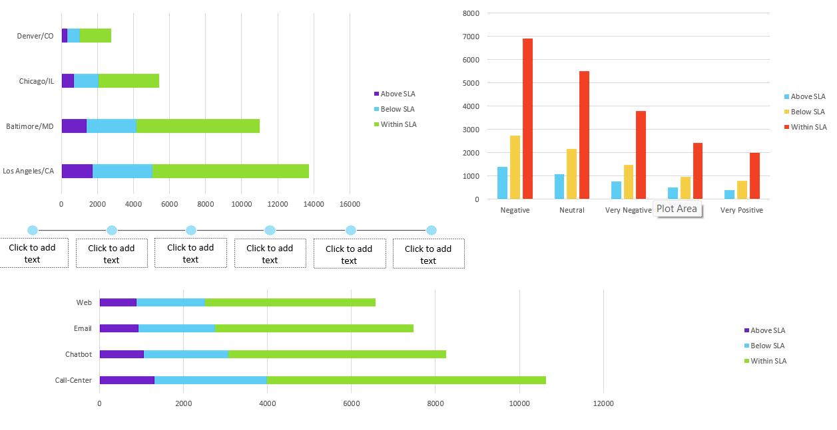
Instructions
Response time analysis
While the majority of call centers are diligently striving to conduct their operations within the stipulated Service Level Agreements (SLA), the presence of a considerable number of SLA misses poses a noteworthy concern. These discrepancies have the potential to elicit negative responses from customers, highlighting the imperative for call centers to proactively address and mitigate instances of SLA hits.
Across various communication channels, the overall performance is commendable, with a substantial portion of tasks completed within the designated SLA. However, the persistence of a significant number of SLA misses and hits remains a challenge, posing a risk to the overall quality of operations. It is essential for call centers to focus on refining their processes and minimizing SLA breaches to ensure a consistent and high-quality service delivery across all channels. This proactive approach is vital for sustaining positive customer experiences and upholding operational excellence.

Slide 7
Score Analysis

Slide 8
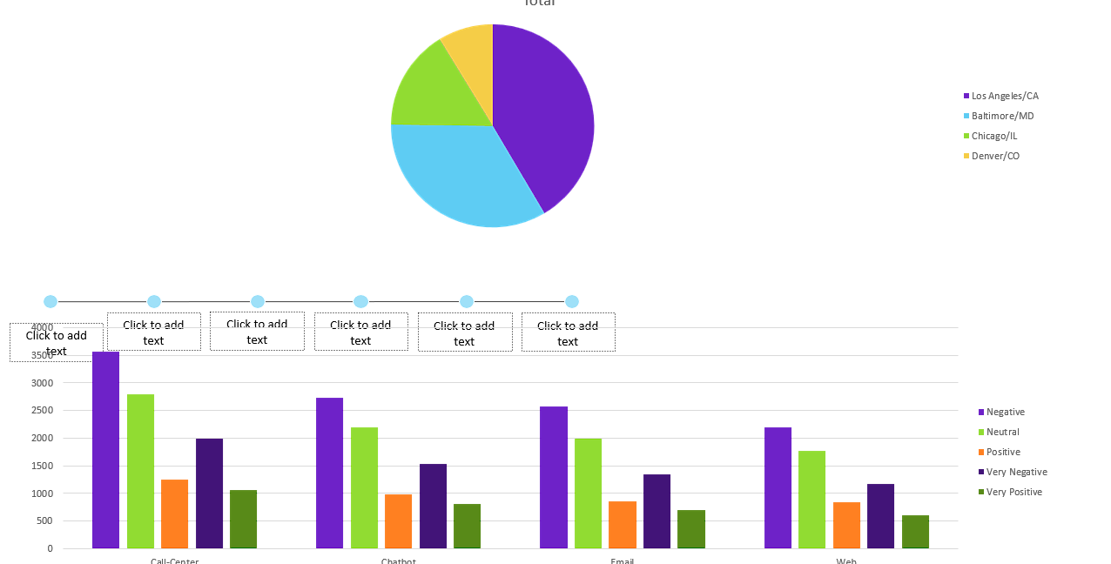
Instructions
Score analysis findings
Los Angeles (LA) stands out with the highest number of received ratings, followed by Baltimore, Chicago, and Denver. This distribution may be attributed to the prevalence of call centers in these respective areas, suggesting a correlation between the number of call centers and the volume of customer ratings.
Across all communication channels, the predominant trend in customer reviews indicates the highest occurrence of neutral responses, followed by positive, very negative, and very positive feedback. Notably, the substantial prevalence of negative reviews may be indicative of challenges such as a high incidence of SLA hits and misses, an undue emphasis on billing-related queries at the expense of other concerns, or an uneven distribution of call centers within the specified regions. Addressing these issues systematically and prioritizing a balanced approach to customer service could contribute to a more favorable overall customer sentiment and improved ratings.

